Slide 1
IOT MINI PROJECT
Under the guidance of Prof. Mrs. Meena Ugale

Slide 2

INTRODUCTION TO IOT
WHAT IS IOT?
The Internet of Things refers to the ever-growing network of physical objects that feature an IP address for internet connectivity, and the communication that occurs between these objects and other Internet-enabled devices and systems.

Slide 3
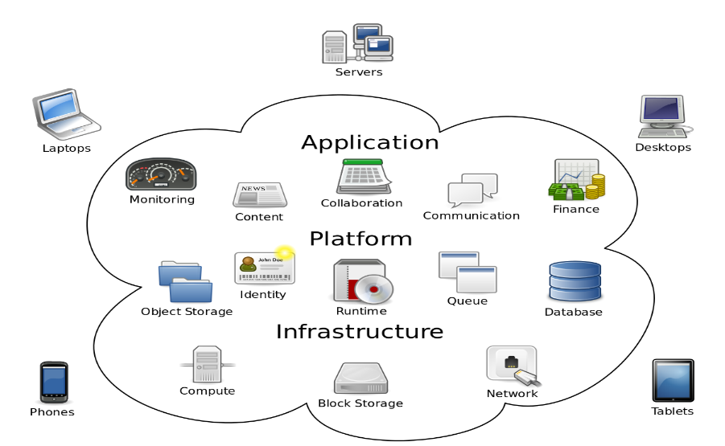
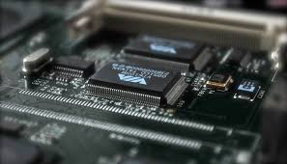


Four Main Components Used In IOT
Low-power embedded systems
Availability of big data
Cloud computing
Networking - connection

Slide 4
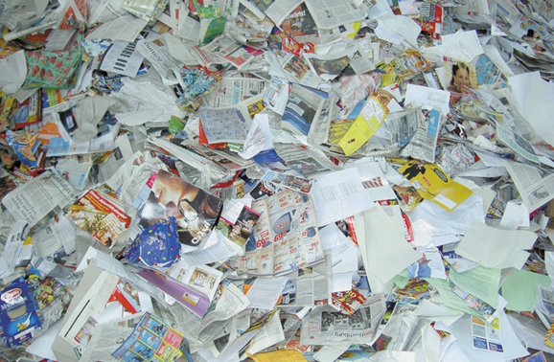
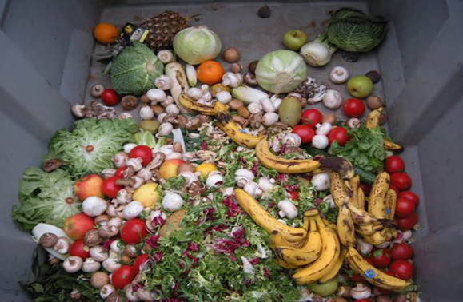
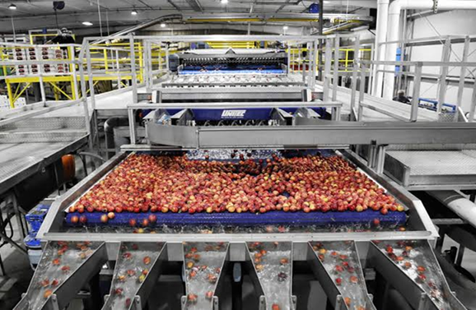
COLOR SORTING MACHINE
PROBLEM STATEMENT
Caters to the need to sorting products according to color.
Can provide systematic color sorting technique.
Can count the number of items produced.
Combination of sensors in one machine.
Can reduce usage of multiple, bulky machines.

Slide 5

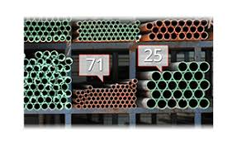
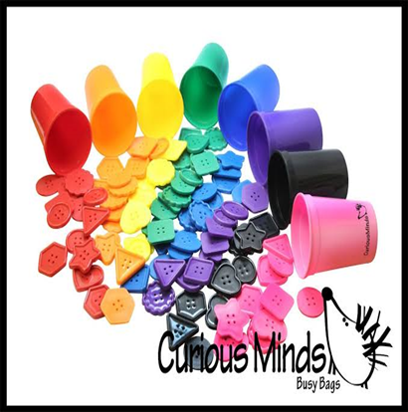
AIMS AND OBJECTIVES
To sort products according to their color.
To implement color sorting as well as counting of the products.

Slide 6
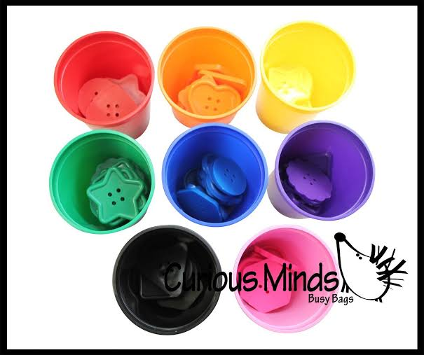
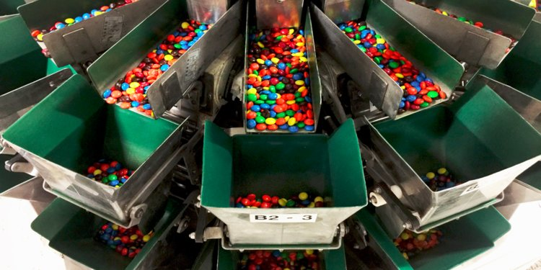
AIMS AND OBJECTIVES
To maintain organized segregation of products and simplify manufacturing processes.
To keep track of products in bulk producing industries.

Slide 7
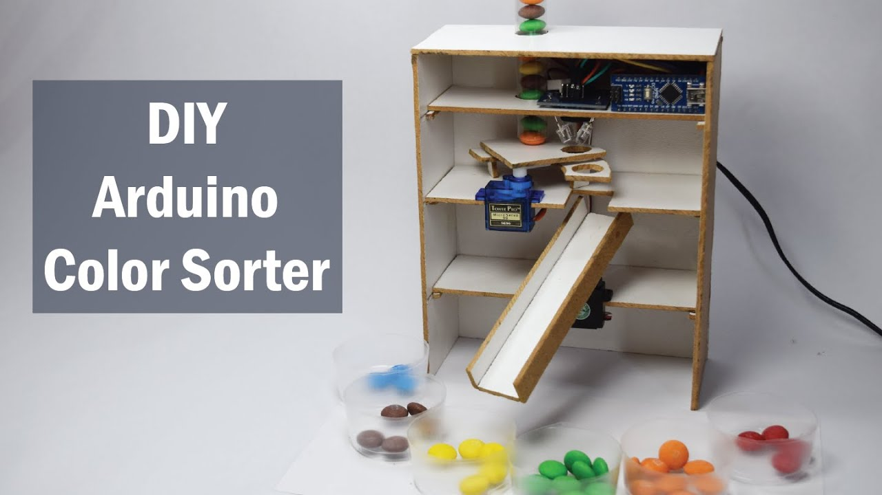
FEATURES
Simplifying the task such as recognizing or differentiating colors.
Using servo motors, the implementation becomes easy.
Provides a smooth conveyer for the objects.
Large amount of objects of different colors can be sorted quickly.

Slide 8
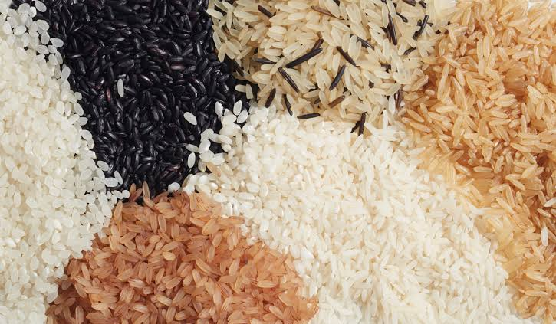
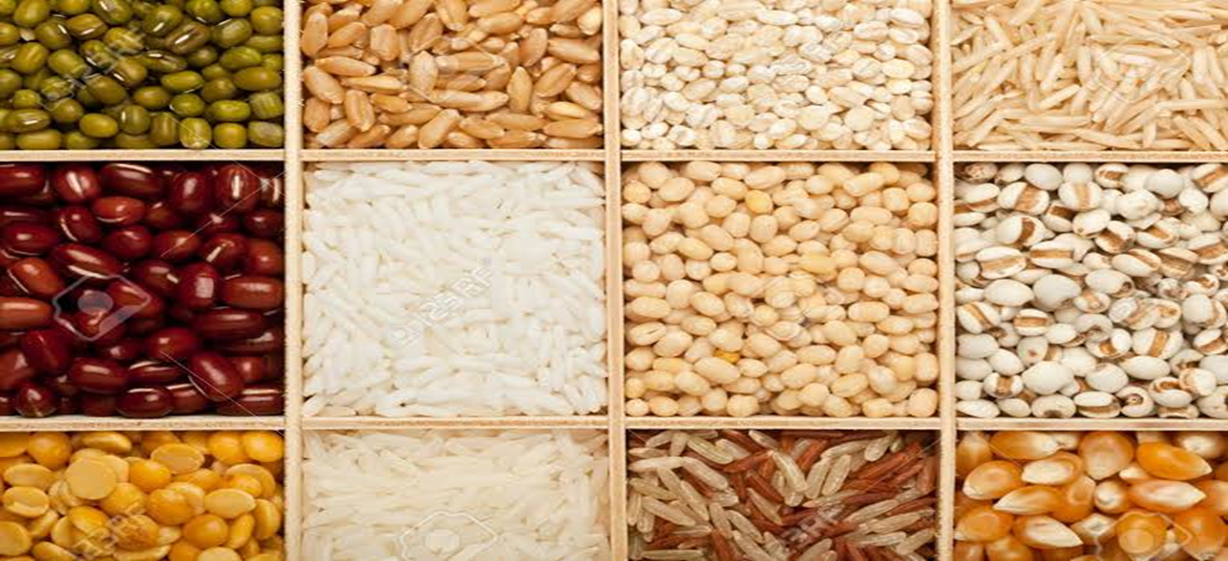
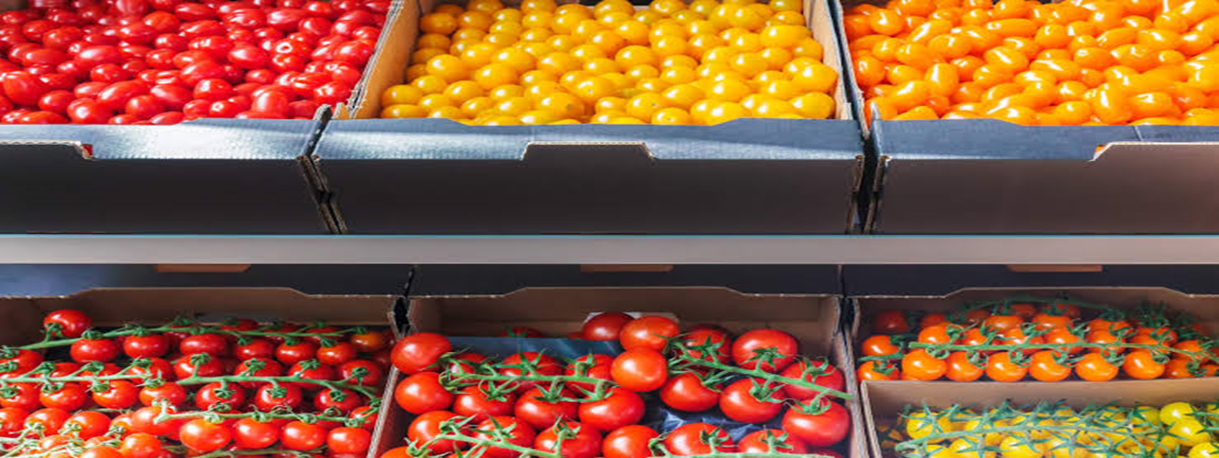
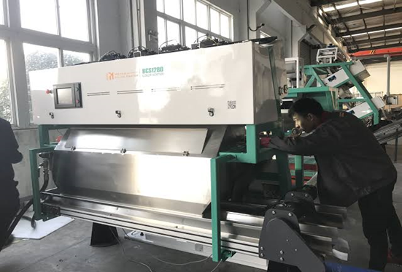
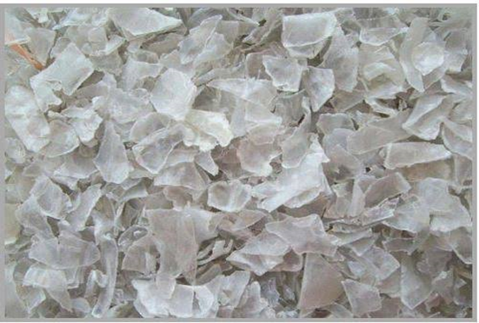
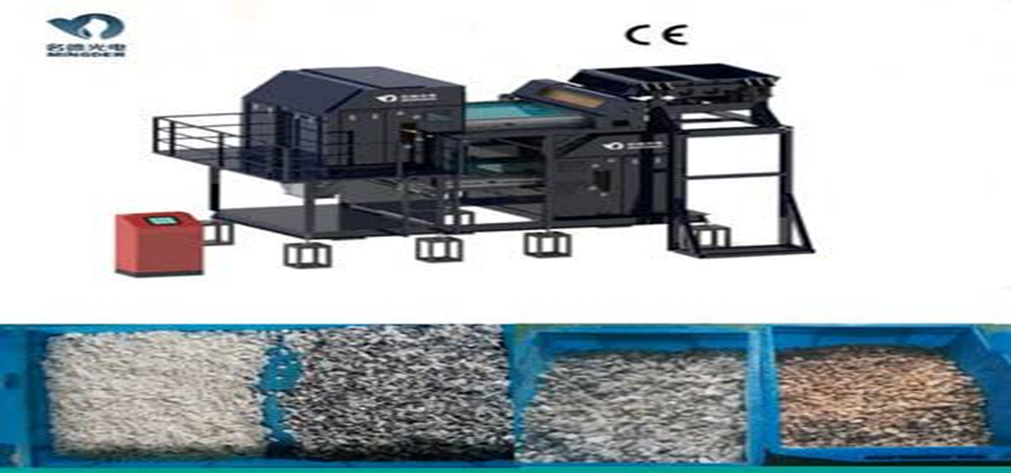
APPLICATIONS
RICE INDUSTRY GRAIN INDUSTRY FRUIT/VEGETABLE INDUSTRY
PLASTIC FLAKE SORTING MACHINE
PLASTIC FLAKES
DIAMOND/MINING INDUSTRY

Slide 9
SCOPE
Sort objects quickly according to colour.
It reduces labour cost.
It reduces manual work.
It reduces time consumption
By using IR sensor it can count the number of objects.

Slide 10
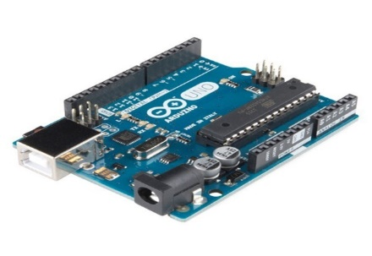
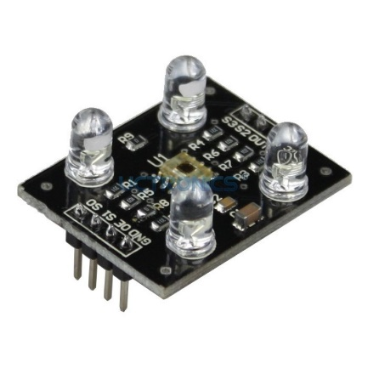
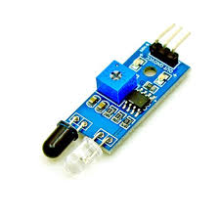
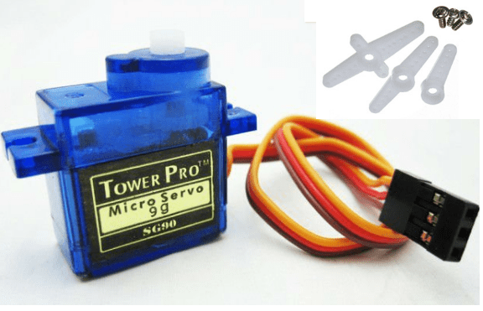

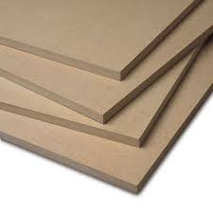
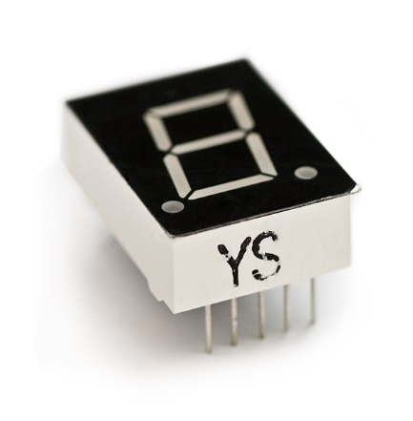
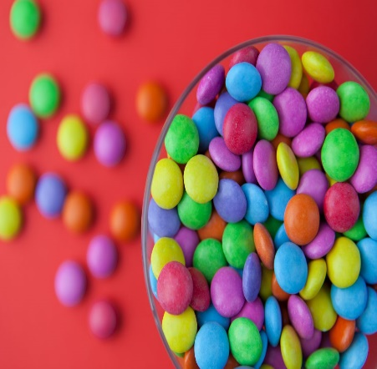
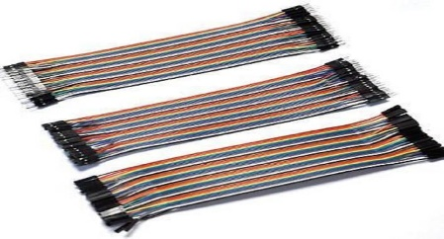
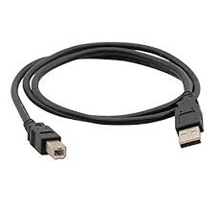
HARDWARE
Arduino
TCS3200 Colour Sensor
IR Sensor
Hobbyist Servo Motors
Fibre Board
7 Segment Display
Coloured Objects
Jumper Wires &
USB cable

Slide 11
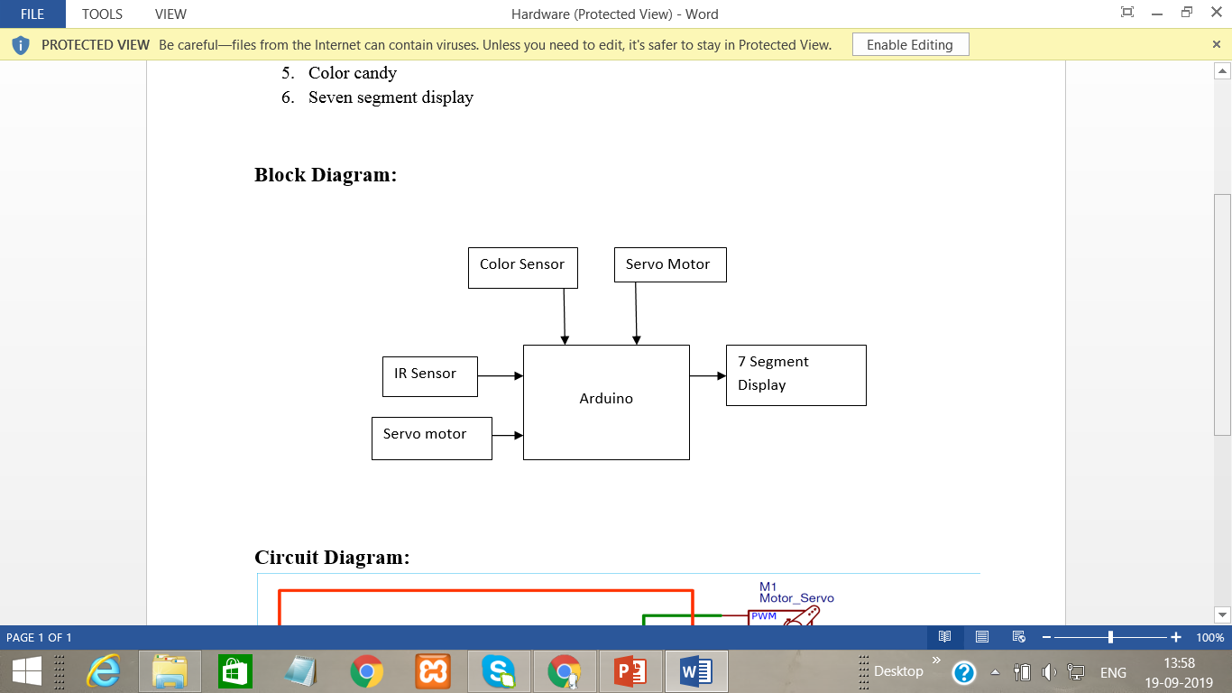
BLOCK DIAGRAM
Serial
Monitor

Slide 12
References
1 | https://www.google.com/url?q=https%3A%2F%2Fwww.geeksforgeeks.org%2Fintroduction-to-internet-of-things-iot-set-1%2F&sa=D&sntz=1&usg=AFQjCNGsZEe2MVCdy-G8BpMEWwfbZvVNwg
2 | https://www.google.com/url?q=https%3A%2F%2Fwww.linkedin.com%2Fpulse%2F20-real-world-problems-solved-iot-c-thomas-tom-smith-iii&sa=D&sntz=1&usg=AFQjCNGI9d3-Jx_5c545-QNkD1w66AWALg
3 | https://www.google.com/url?q=https%3A%2F%2Fwww.edureka.co%2Fblog%2Fiot-applications%2F&sa=D&sntz=1&usg=AFQjCNHAbcFe4eDCZ-Ce_Rl6DakoSDVfpw
4 | https://circuitdigest.com/microcontroller-projects/arduino-color-sorter-machine-using-tcs3200-color-sensor
5 | https://howtomechatronics.com/projects/arduino-color-sorter-project/
6 | https://www.youtube.com/watch?v=g3i51hdfLaw
7 | https://nevonprojects.com/iot-color-based-product-sorting-machine-project/
8 | https://www.playembedded.org/blog/an-object-counter-using-an-ir-sensor-and-arduino/
9 | http://surajpassion.in/ir-obstacle-sensor-with-arduino/
10 | https://www.mepits.com/project/274/embedded-projects/arduino-based-color-sorting-machine
11 | https://randomnerdtutorials.com/arduino-color-sensor-tcs230-tcs3200/

Slide 13
THANK YOU!
PRATYUSH DANDEKAR- XIEIT171809
SHARLENE MARTIN- XIEIT171829
FRANKLIN MATHIAS- XIEIT171830

